Slide 1
The application of Financial Statistical Method
Zhikang dong YUE ZHENG
TAO HUANG
Xueyuan fan CHUI kong
Wenjun yang

Slide 2
OVERVIEW
Data Description
Portfolio Theory
Time Series Analysis
Risk Management
Universal Portfolio
Copula

Slide 3
Background
Choose 15 assets from different industries
Use S&P500 as the benchmark to evaluate the performance
The 15 equities are: (from 12/01/2015 I to 04/01/2020, daily frequency)：
3M(MMM), American Express(AXP), Apple. Inc(AAPL)，Boeing(BA), Caterpillar Inc(CAT), Chevron Corporation(CVX), Cisco Systems(CSCO), The coca-cola Company(KO), Johnson & Johnson(JNJ), Nike(NKE), Procter&Gamble(PG), Raytheon Technologies(RTX), UnitedHealth Group(UNH), Verizon(VZ), The Walt Disney Company(DIS)

Slide 4
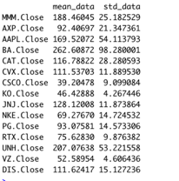
Data Description
Vary most: Boeing
Reason: Safety Scandal in 2018
and covid-19 effect
Vary least: Coca-Cola
Reason: Consumption Industry

Slide 5
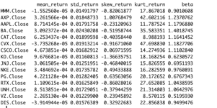
Data Description
Beta: a measure of volatility compared to the market (beta of S&P500 =1)
half of these equities are more risky than the market

Slide 6

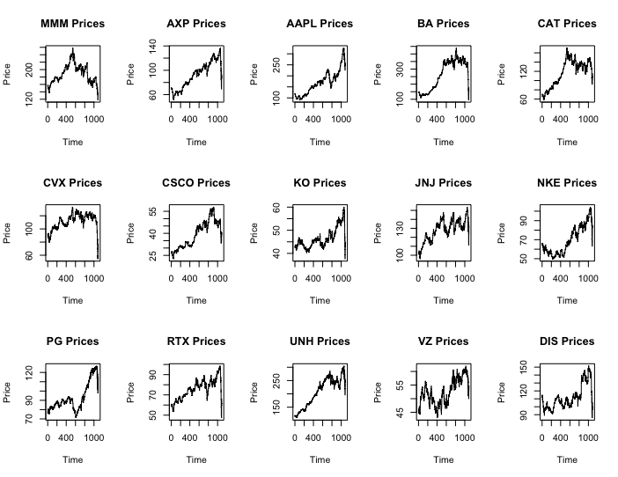



Graph of Stocks
Generally upward trending
Covid-19 effect:
The stock prices decrease significantly, and some companies has returned to stock price level of 2015

Slide 7
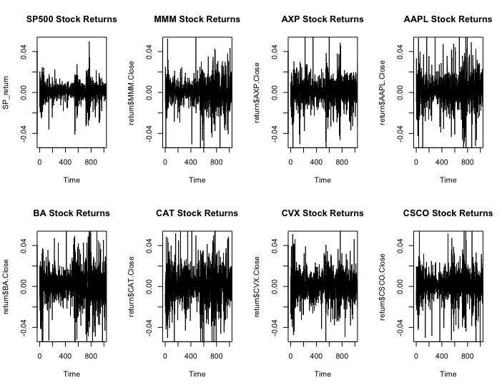
Graph of Stock Return

Slide 8
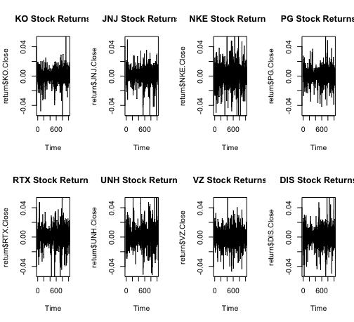
Graph of Stock Return

Slide 9
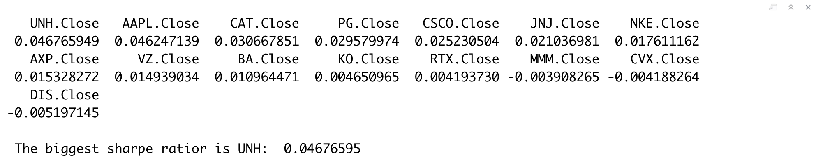
Sharpe Ratio

Slide 10
Portfolio Theory
MVP and tangent portfolio
Portfolio with no short sell
Portfolio with short sell

Slide 11
MVP and tangent portfolio
MVP
The minimum variance portfolio is the portfolios that provides the lowest variance (standard deviation) among all possible portfolios of risky assets.
Tangent portfolio
The tangency portfolio is the portfolio with the highest Sharpe ratio.

Slide 12
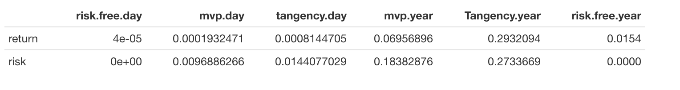
Daily & Annual(no short)
The return of MVP is higher than the yearly risk free rate(1.54%) by 5.42%.
The return of tangent portfolio is higher than yearly risk free rate (1.54%) by 27.78%.

Slide 13
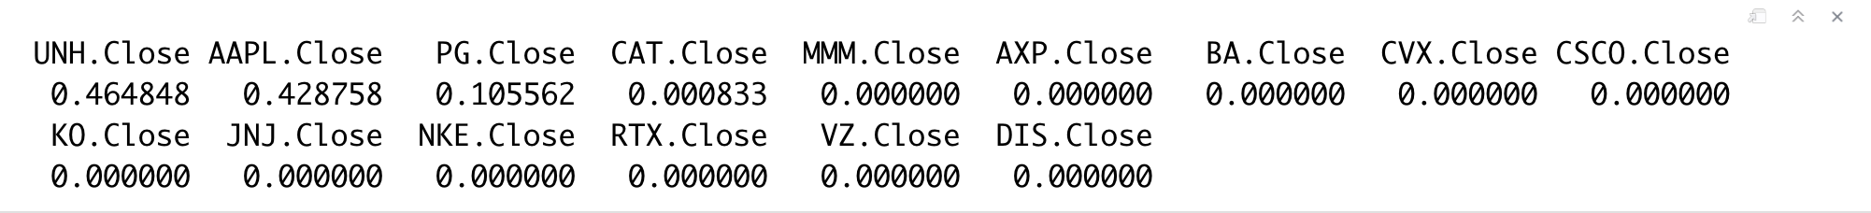
Tangent portfolio
Sharpe Ratio

Slide 14
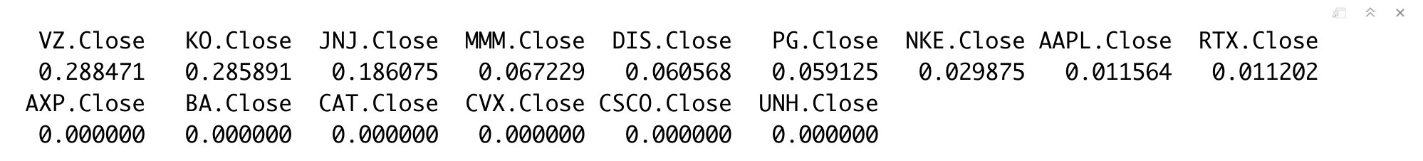
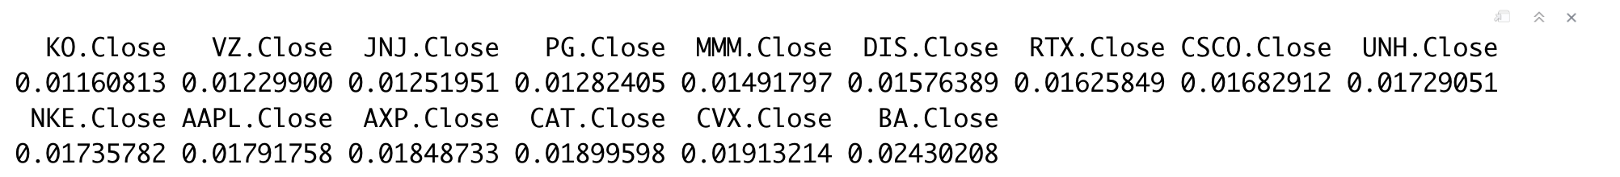
Standard Deviation
MVP

Slide 15
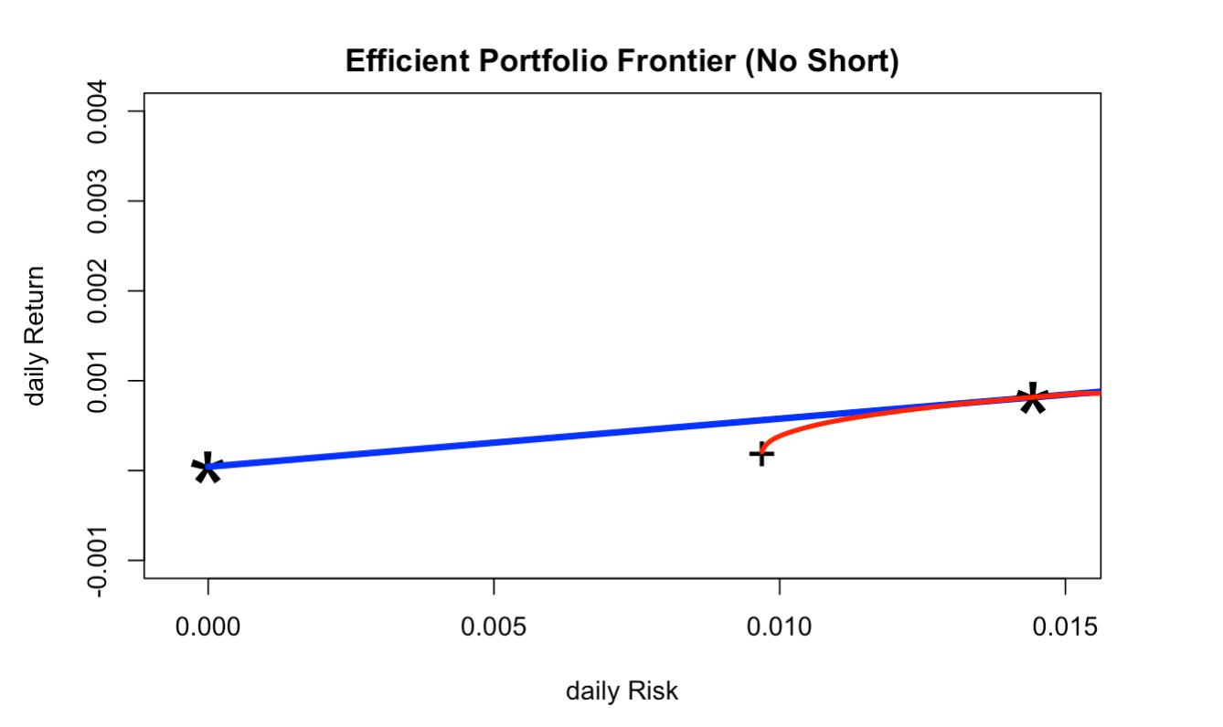
Efficient Frontier (no short)

Slide 16
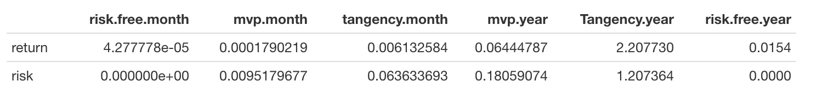
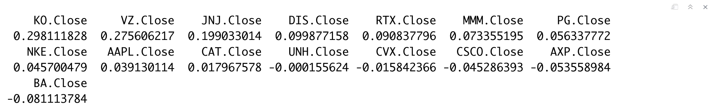
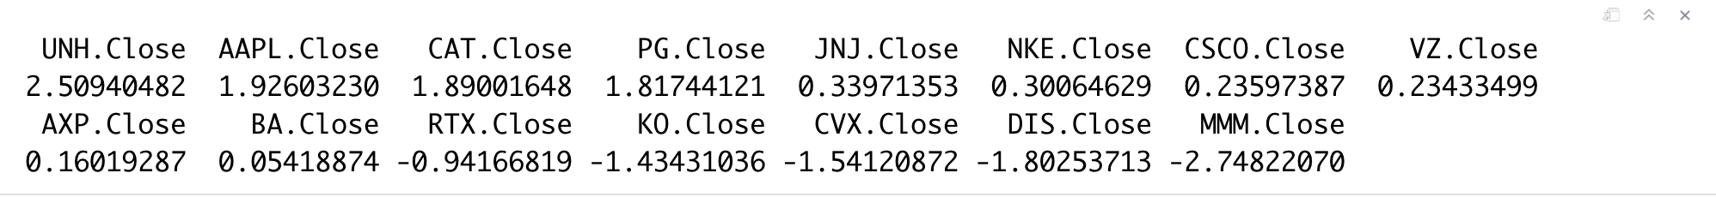
Portfolio with short sell
MVP
Tangent Portfolio

Slide 17
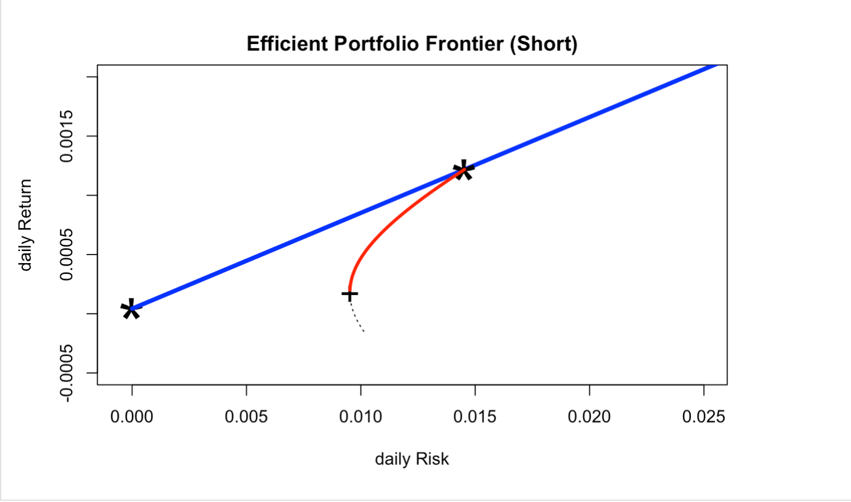
Efficient Frontier (with short)

Slide 18
Time Series Analysis
Time-Varying Betas
Minimum Variance Portfolios
Forecasting

Slide 19

Time-Varying Betas
CAMP model:
$$r_{t}=α+βr_{m, t}+ε_{t}$$
$$\hat{β}=\frac{\text{Cov} (r_{t}, r_{m, t})}{\text{Var} (r_{m, t})}$$

Slide 20
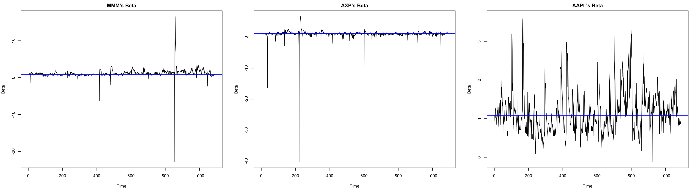
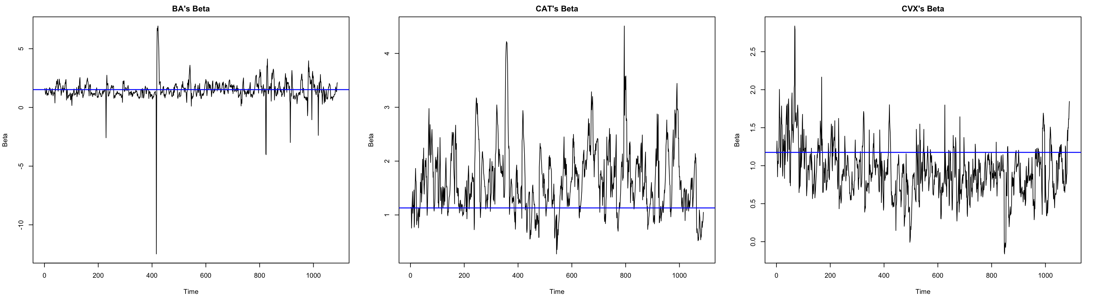

Slide 21
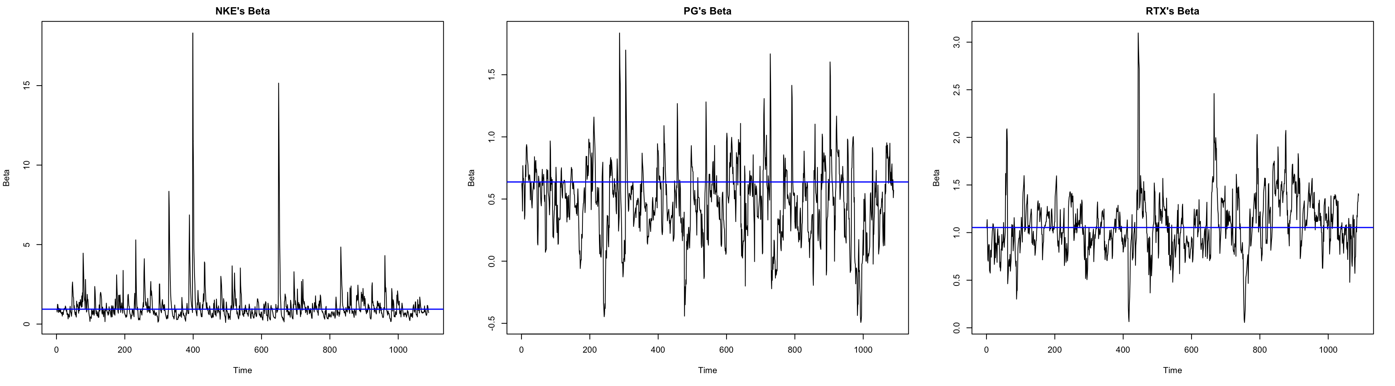
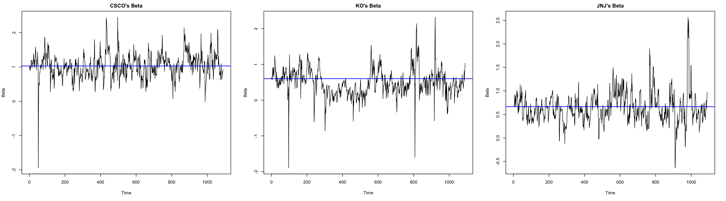

Slide 22
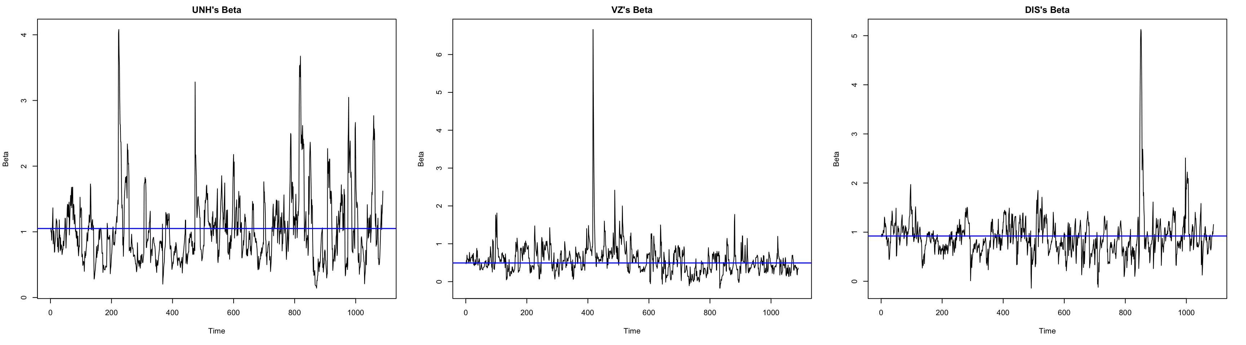
Time-Varying Betas

Slide 23

Time-Varying MVP
Assume short selling is NOT allowed
Select five stocks which have a positive $α$ and small $β$
PG, KO, VZ, JNJ, DIS
Solve the quadratic optimization problem
$\min_{w} w^{′}V_{t}w \text{such} \text{that} \sum_{i=1}^{k}{w_{i}}=1 \text{and} w_{i}≥0$

Slide 24
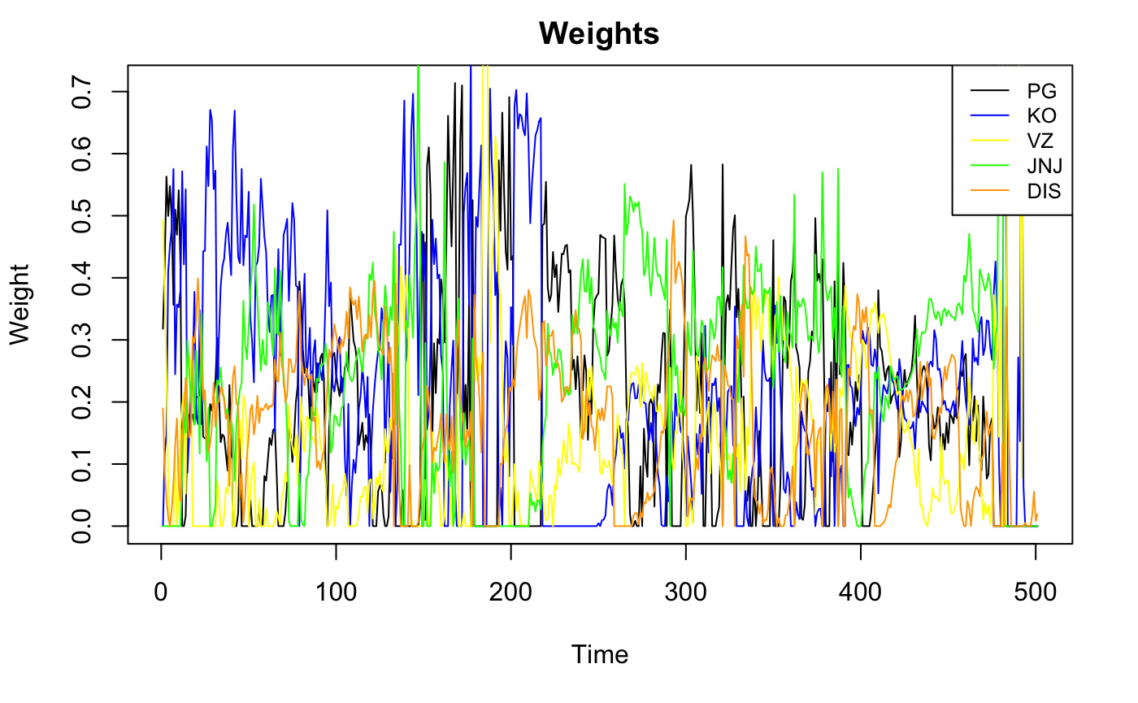
Time-Varying MVP

Slide 25
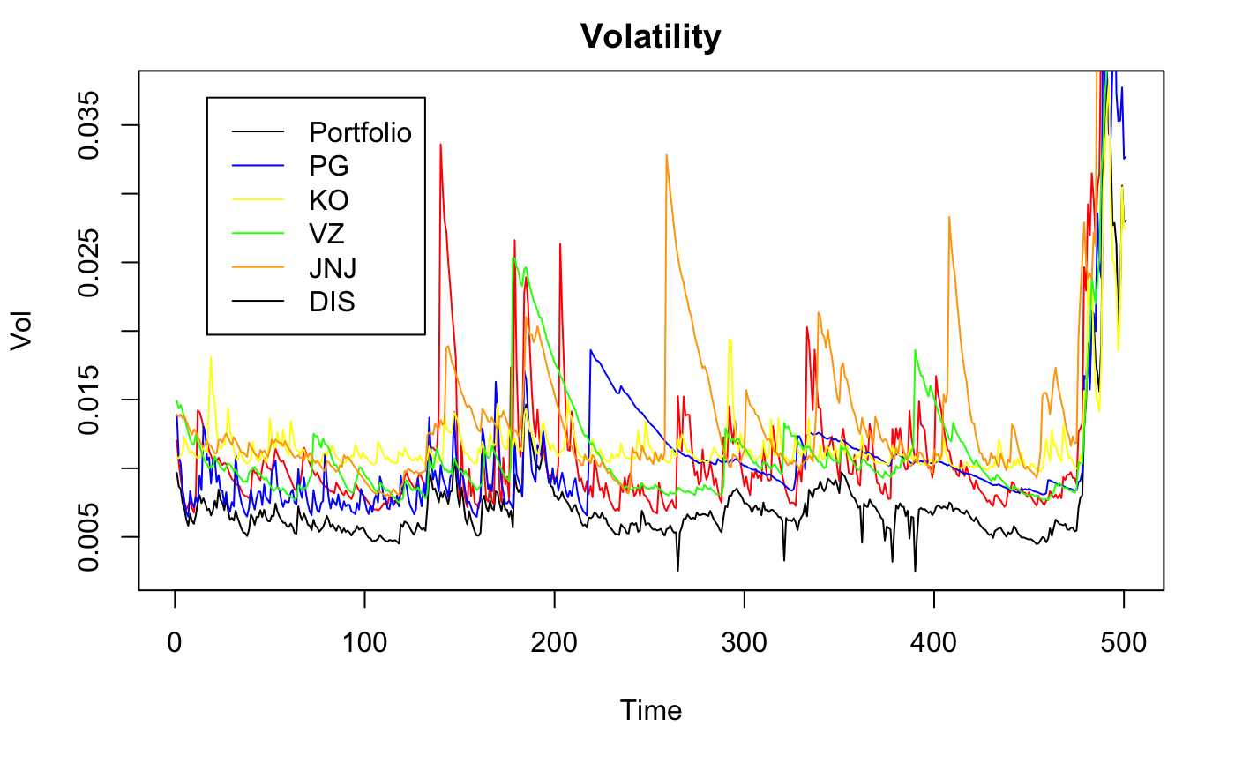
Time-Varying MVP

Slide 26
Forecasting
Analyzing daily price change
ARMA-GARCH model
ARMA: expected value of price change
GARCH: expected value of volatility

Slide 27
Forecasting-One step ahead
Stock | meanForecast | meanError | SD
PG | 0.2516707 | 5.543471 | 5.543471
KO | 0.0136311665 | 1.969738 | 1.969738
VZ | 0.0195942697 | 1.366333 | 1.366333
JNJ | -0.0015551330 | 5.977686 | 5.977686
DIS | 0.18674672 | 6.379339 | 6.379339

Slide 28
Forecasting-Two steps ahead
Stock | meanForecast | meanError | SD
PG | 0.0000000 | 5.543774 | 5.535937
KO | -0.0002477449 | 1.945809 | 1.945480
VZ | -0.0003691687 | 1.310983 | 1.310730
JNJ | -0.0003091272 | 5.927048 | 5.926557
DIS | 0.03016133 | 6.401113 | 6.387171

Slide 29
Universal Portfolio

Slide 30
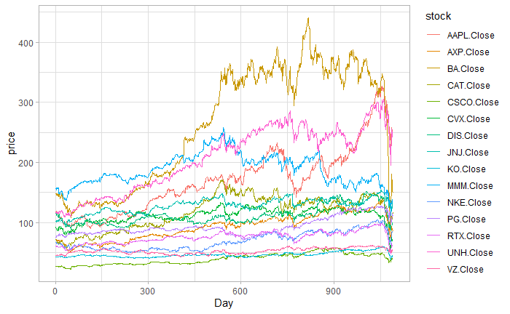
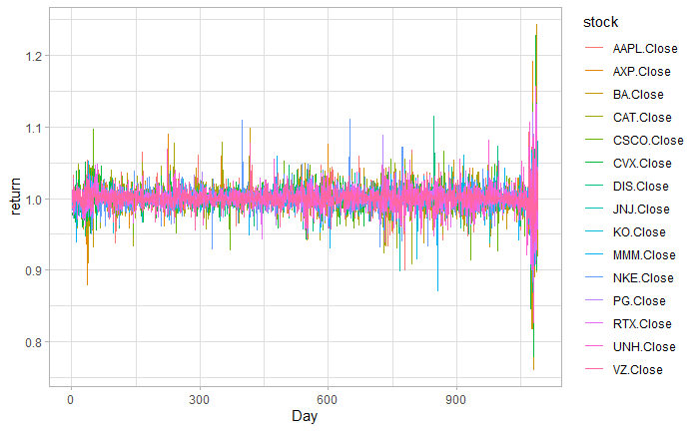
Date range: 2015-04-01 ~ 2020-04-01
Overview: The price and return of most of the selected stocks had remained quite steady until the outbreak of COVID19 in America. However, during the outbreak, the market has witnessed four meltdowns in merely ten days. The great impact from the pandemic can be seen from the steep drops and big fluctuations in the two graphs above.

Slide 31
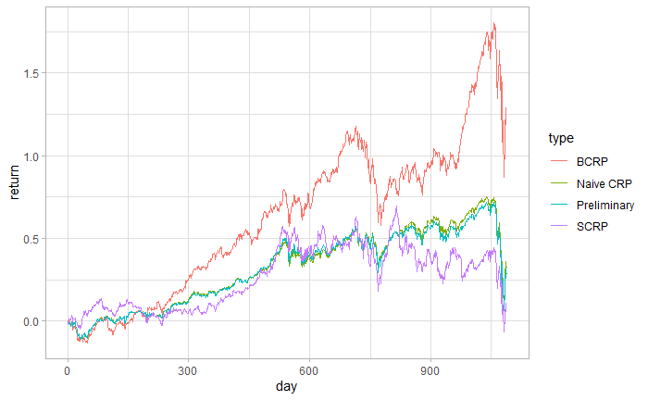
Method | Preliminary | Naïve CRP | BCRP | SCRP
Overall Return | 28% | 32% | 125% | 8.5%
Preliminary Portfolio:
Get a portfolio consisting of 15 stocks with equal total value, and don’t make any adjustment the whole time.
Naïve CRP:
Adjust the shares we hold on each stock according to the change in their value and ensure the allocation proportion of different stocks remain the same (in this case, it would be 1/15).
BCRP:
BCRP is to maximize the portfolio wealth at time n over all CRP, based on history price and present price (unknown), which makes it unachieved in real life.
SCRP:
SCRP is a strategy similar to BCRP, but only relies on historical data, making it achievable in real life. Each adjustment is the best allocation we can have based on previous data.

Slide 32
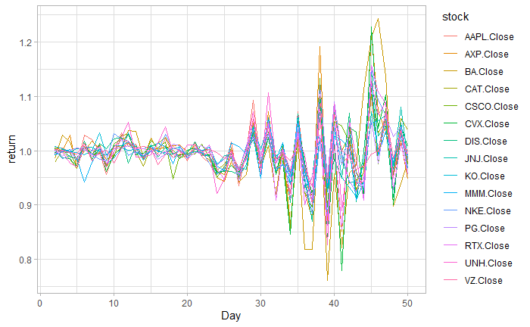
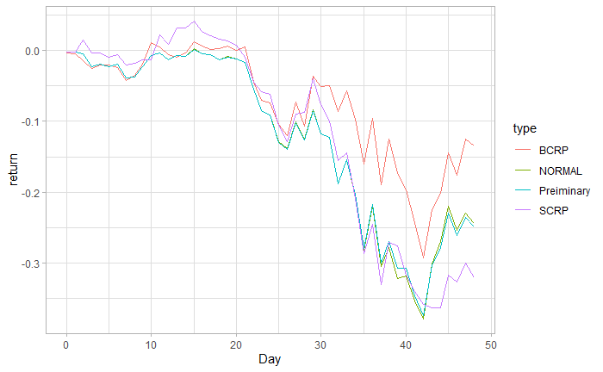
Pre-outbreak and outbreak period
What if I just bought these stocks right before the outbreak?
Method | Preliminary | Naïve CRP | BCRP | SCRP
Overall Return | -25% | -24% | -14% | -32%

Slide 33
Notes for Universal Portfolio:
Naïve CRP is a conservative strategy for that whatever a stock is doing well or not, its proportion in the whole portfolio will be rebalanced to a predetermined value.
SCRP is a more aggressive approach because it will buy in more of the stock that is recently doing well. However, this strategy will fail when the price is volatile and tends to fluctuate a lot.
The fact that SCRP is doing worse than Naïve CRP suggests there is no exact trend in the stocks especially during the recent COVID19 pandemic.
The preliminary portfolio and Naïve CRP are very close to each other. The reason behind that could be the return in each stock is relatively close for that those mega-companies are stable and rarely have big fluctuations in stock price. If this is the case, then the general return will be similar, whether keeping the proportion still or not.
All these strategies can’t stop you from losing money during recent market meltdowns, not even the unachievable best strategy BCRP, as long as you decide to stick to these 15 stocks. The better way to invest your money and keep risk under control would probably be shorting futures and options on stock markets.

Slide 34
Risk Management
Investment: $100,000
Time Horizon: one-month
Estimation: 5% Value-at-Risk and Expected shortfall
Methods: Normal & nonparametric

Slide 35
Risk Management
Two estimations give different results.
The Normal methods turns out BA has max VaR (3964.577) and max expected shortfall (4979.595), KO has min VaR (1898.815) and min expected shortfall(2383.649).
The Nonparametric method turns out CAT has max VaR (2938.054) and max expected shortfall (5756.574), KO has min VaR (1502.872) and min expected shortfall (2815.664).
However, there are some disparities. It happens because not all assets are follow the normal distribution.

Slide 36
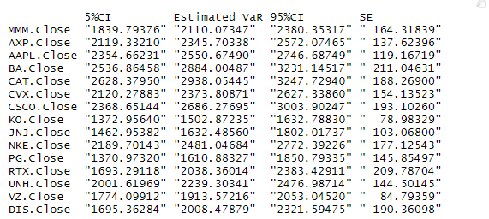
Bootstrap Confidence interval of VaR & Expected Shortfall

Slide 37
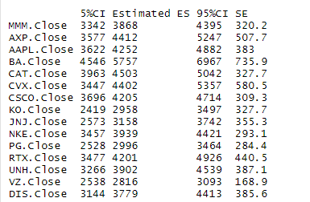
Bootstrap Confidence interval of VaR & Expected Shortfall

Slide 38
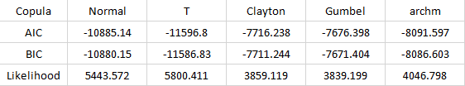
Copula
We compared 5 kinds of copulas: Normal copula, T copula, Clayton copula, Gumbel copula, and archm copula.

Slide 39
Copula
T copula has the lowest AIC and BIC value which means that T copula fits better.
Also, T have the max Likelihood which shows that T copula fits the model better.
Our data shows a slightly heavy tail correlation.
T copula fits the best compared with other copulas. It is good for modeling data since the t-copula emphasizes extreme results

Slide 40
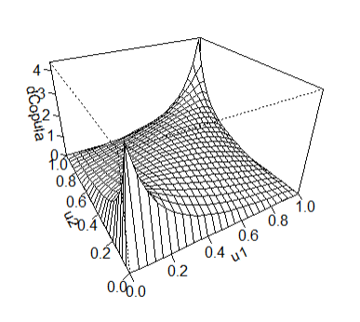
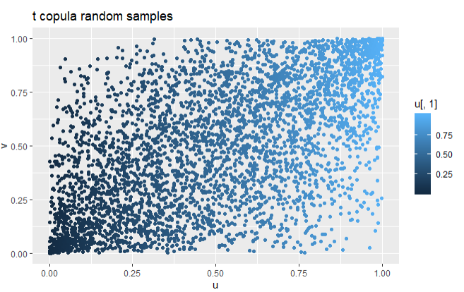
Copula

